Slide 1
Canada Day Twitter Analysis
Data Visualisation
Neha Deshmukh
0640812

Slide 2
Introduction
Twitter analysis of tweets associated with the hashtag #OhCanada
Questions that I have attempted to answer are:
1. Apart from Canada and US, which all countries have tweeted about Canada day?
2. Top 25 frequent words used?
3. Positive and Negative sentiments of people regarding Canada Day.
4. Words associated with each sentiment.
5. Word Network to find out pairs of words occurring together frequently.

Slide 3
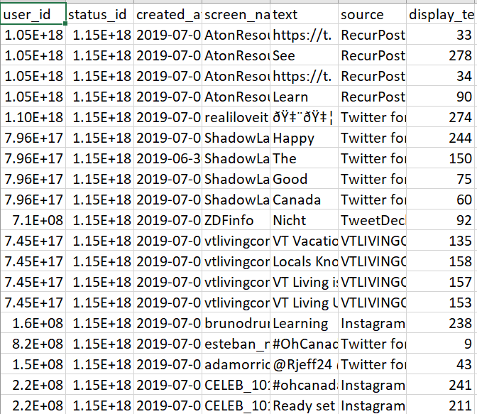
Dataset
Collected data for 4 hours on Canada Day
#OhCanada
Analysed Text

Slide 4
Methodology
Collection of data from twitter on 1st July
rTweet package
streamR package
Cleaned the data
TidyText
StringR
dplyr
Made Visualisations in R and Tableau
Ggraph, igraph and widyR

Slide 5
Four levels of design analysis
Domain
Who is the target?
Abstraction
What and Why?
Idiom
How?
Algorithm
Complexity?

Slide 6
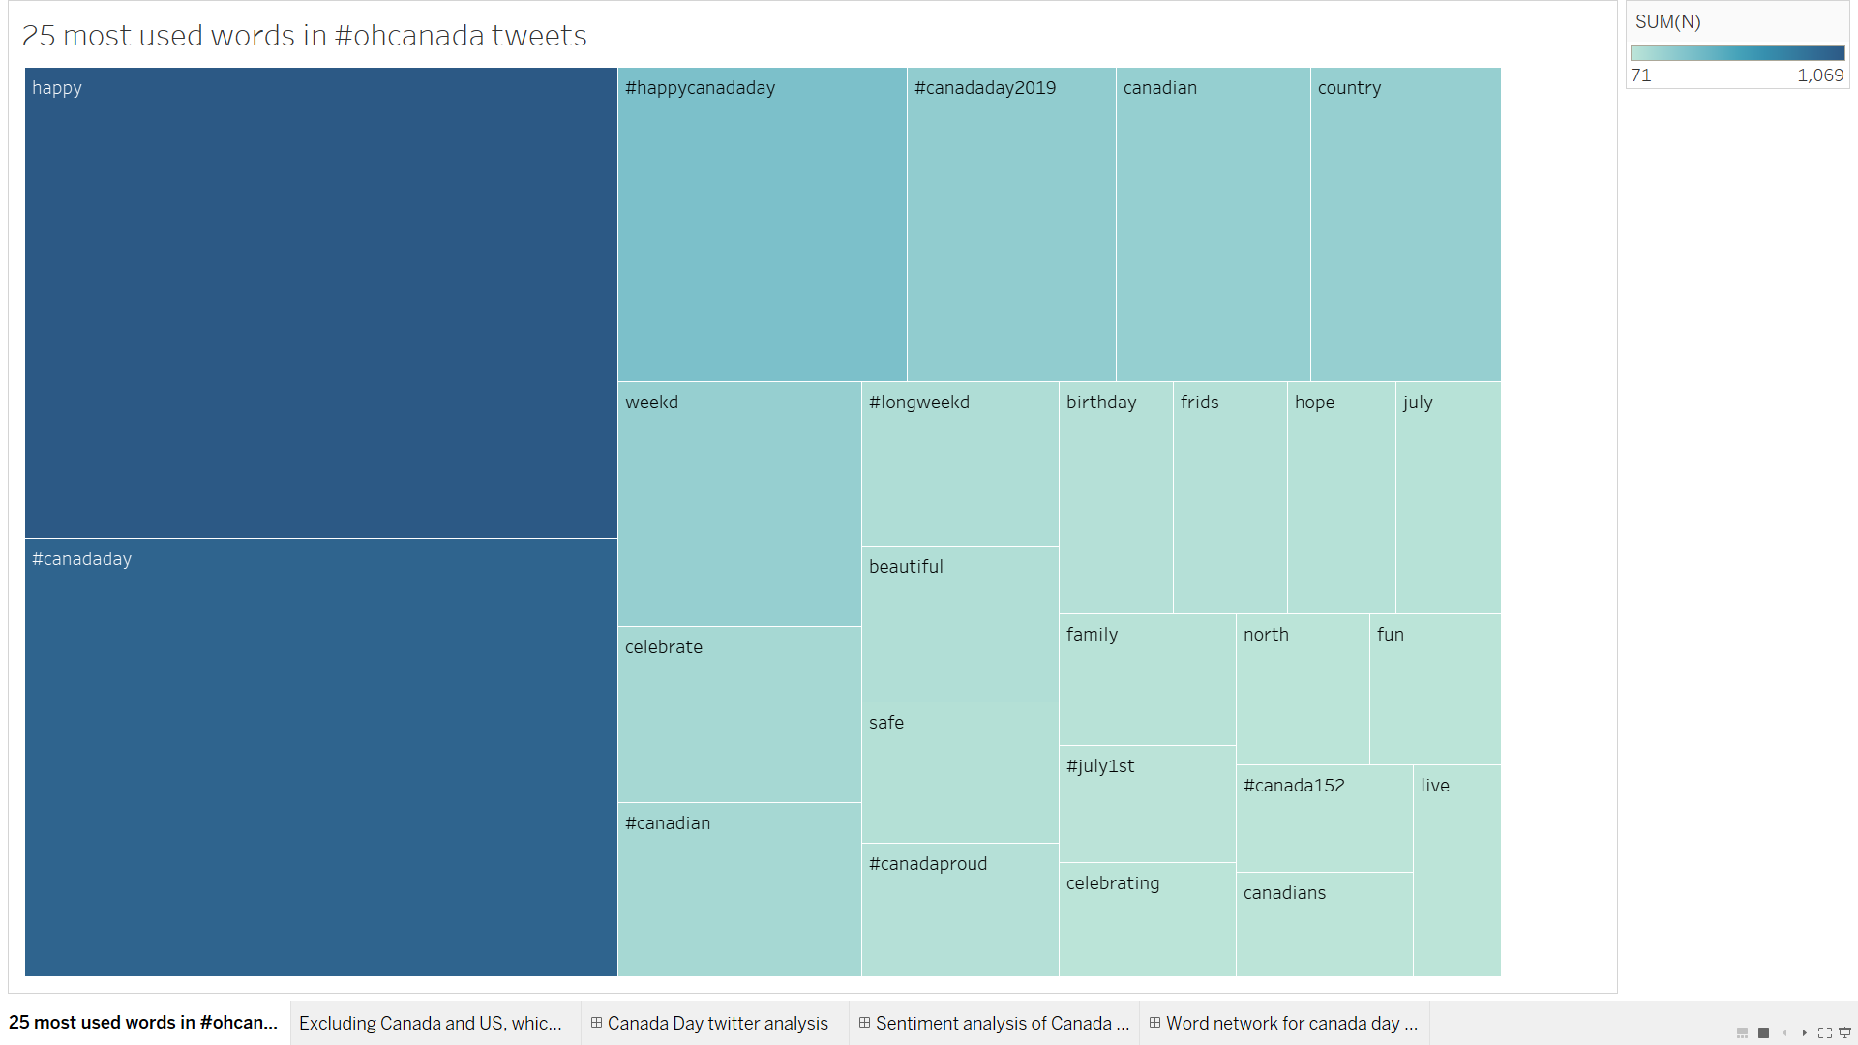
Visualisation 1: Frequent Words

Slide 7
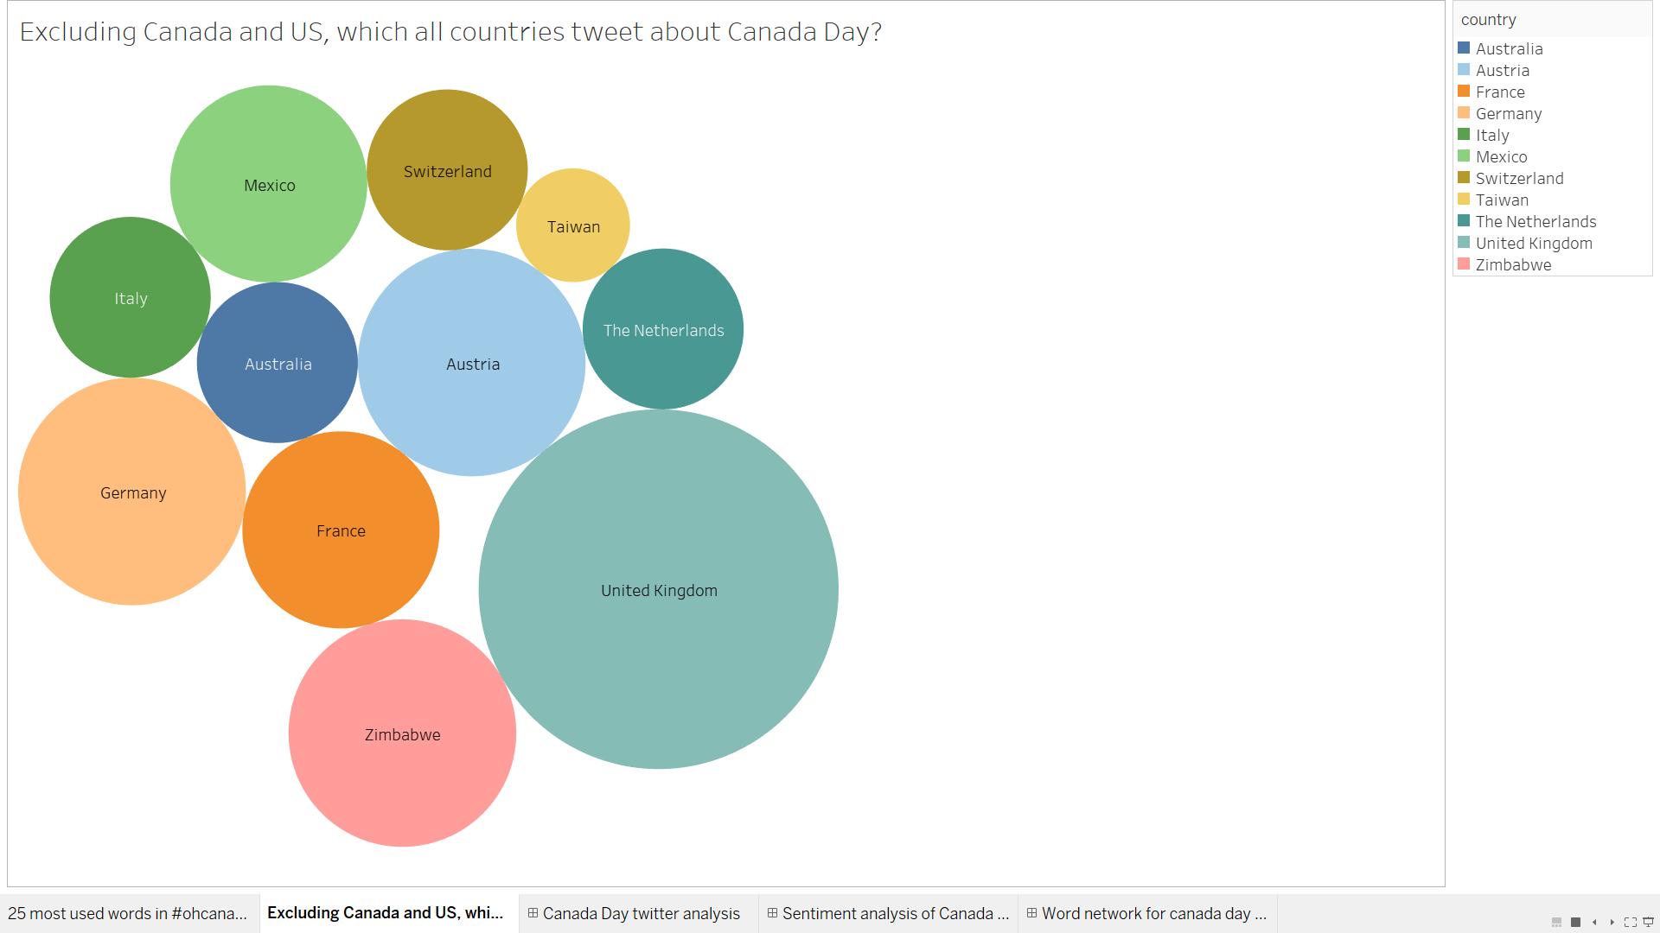
Visualisation 2: Country-wise Analysis

Slide 8
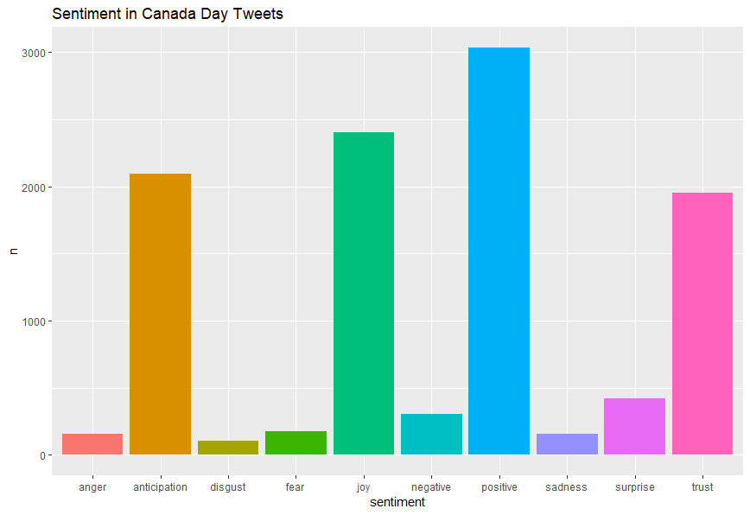
Visualisation 3: Sentiment Analysis
Code Snippet:
tidy.all %>%
filter(word!="canada")%>%
inner_join(get_sentiments("nrc")) %>%
count(sentiment, sort=TRUE)%>%
ggplot(aes(sentiment, n, fill=sentiment)) +
geom_bar(stat = "identity") +
theme(legend.position="none")+
labs(title = "Sentiment in Canada Day Tweets")

Slide 9
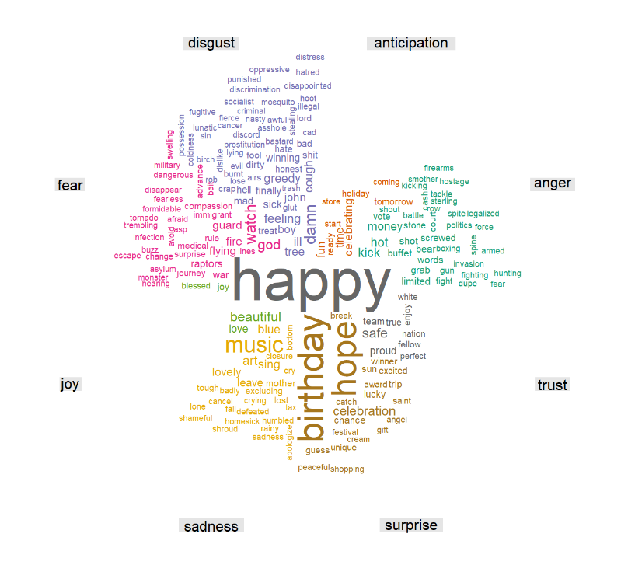
Visualisation 4: WordCloud
Code Snippet
tidy.all %>%
filter(word!="canada")%>%
inner_join(get_sentiments("nrc")) %>%
filter(!sentiment %in% c("positive",
"negative"))%>%
count(word,sentiment, sort=TRUE)%>%
acast(word ~ sentiment, value.var = "n", fill = 0) %>%
comparison.cloud(colors = brewer.pal(8, "Dark2"),
title.size=1.0, max.words=200)

Slide 10
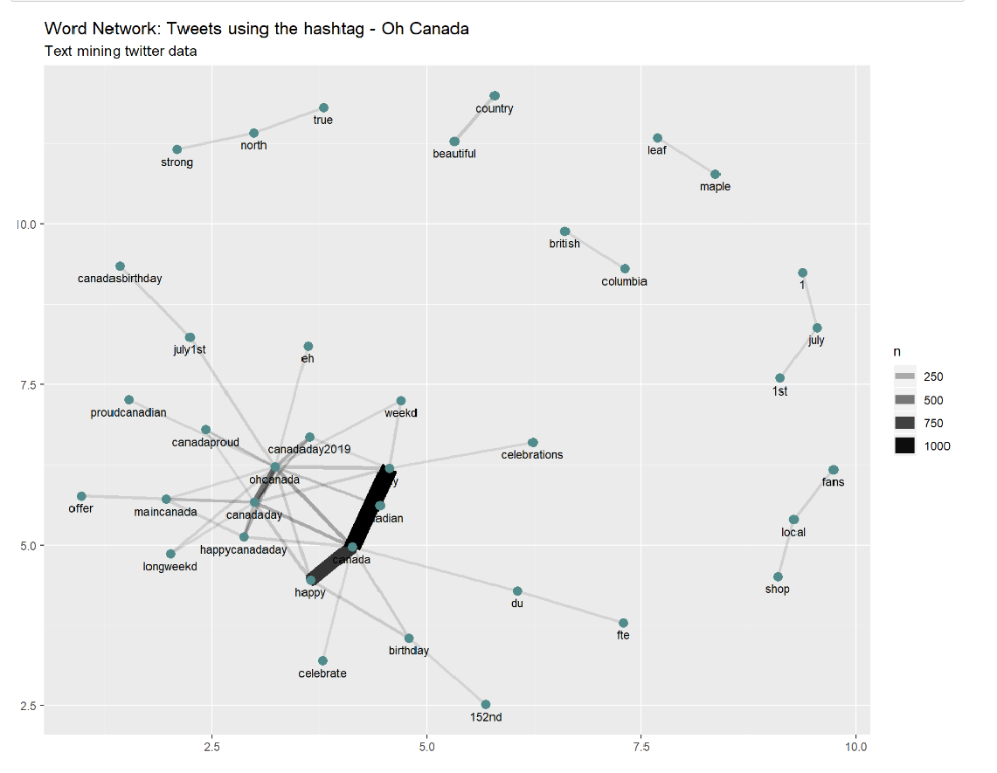
Visualisation 5: Word Network
Code Snippet
canada_words_counts %>%
filter(n >= 18) %>%
graph_from_data_frame() %>%
ggraph(layout = "fr") +
geom_edge_link(aes(edge_alpha = n, edge_width = n)) +
geom_node_point(color = "darkslategray4", size = 3) +
geom_node_text(aes(label = name), vjust = 1.8, size = 3) +
labs(title = "Word Network: Tweets using the hashtag - Oh Canada",
subtitle = "Text mining twitter data ",
x = "", y = "")

Slide 11
Conclusion
Negative sentiments also present
Countries other than Canada also tweet about Canada Day

Slide 12
Thank You!

